Slide 1


Modern Honey Network: An Investigation into MHN, Deployment & Analysis of Collected Data
JAMES FINGLAS – 2019/20 Network Security Analytics B00094138@STUDENT.ITB.IE

Slide 2
Contents:
WHAT IS MHN?
WHAT HONEYPOTS DOES IT OFFER?
DEPLOYMENT CONSIDERATIONS
GENERAL DATA ANALYSIS SAMPLES
GENERAL DIONAEA ANALYSIS SAMPLES
MOST INTERESTING HITS ON SSH PORT
A THREAT INTELLIGENCE USE CASE EXAMPLE VIA SNORT/P0f

Slide 3
1. What is MHN?
Rapid Honeypot deployment platform written in Python
Aims to simplify Deployment of honeypot sensors on servers
Aims to put the power of Threat Intelligence and Easy data mining in the hands of Novice users as well professionals

Slide 4
2. What HONEYPOTs DOES IT OFFER?
Conpot: emulates utility based servers
Drupot/Magenpot: Anti spambot honeypot
WordPot: Wordpress honeypot
Shockpot: Dedicated to detecting CVE-2014-6271
P0f: Fingerprint scanner
Suricata/Snort: IDS/IPS
Glastopf/Elastichoney: web server honeypots
Amun/Dionaea: Low interaction vulnerability malleable malware honeypots.

Slide 5
3. Deployment Considerations
What and why?
ConPot: to appear as an industrial or utilities-based server
Cowrie: To capture SSH based data
ShockPot: To determine if the CVE (CVE-2014-6271) related to ShockPot is still being screened for
Dionaea: because malware is the principal type of attack
ElasticHoney: to attempt to detect web-based deployment attack agents
Glastopf to compliment ElasticHoney and detect web-based attacks
Snort: as a detection and protection measure
p0f: as my passive port fingerprint sniffer

Slide 6
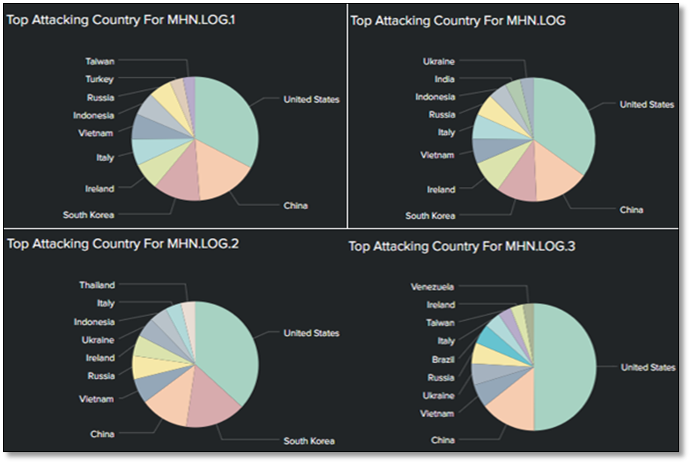
4. General DATA ANALYSIs SAMPLES
Top Source Region, United states
Top Attack City: Macroom, Co. Cork
Top Honeypot by Type: Dionaea
Top Ports: 1433, 22. 80, 443, 465, 3306
Top Victim machine India based

Slide 7
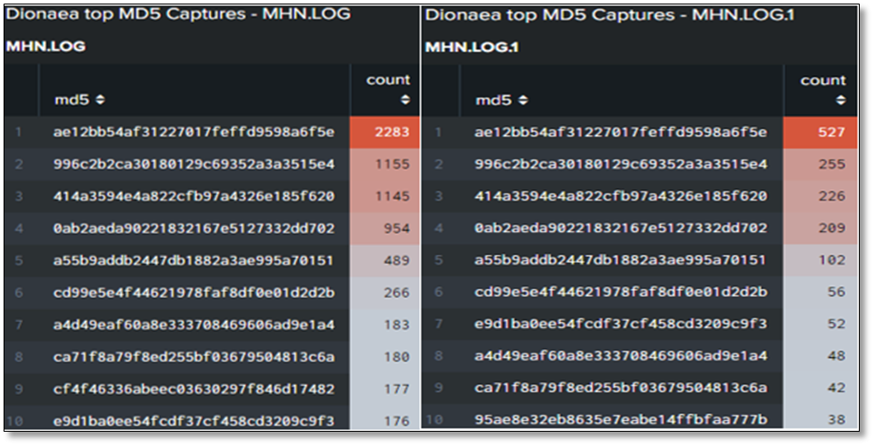
5. General DIONAEA ANALYSIs SAMPLES
Here we see a sample of the top hashes detected by Dionaea
These I investigated further via Virus-Total & other sources such as threatfeeds.io
A sample of these findings can be seen on the next slide

Slide 8
5. General DIONAEA ANALYSIs SAMPLES CONTD’
ae12bb54af31227017feffd9598a6f5e: 63 engine detections. This is a variant of WannaCry ransom-ware [1]
ca71f8a79f8ed255bf03679504813c6a: 52 engine detections. This is a back-door worm CVE [2]
cd99e5e4f44621978faf8df0e01d2d2b: 65 engine detections. This is a variant of WannaCry ransom-ware [3]

Slide 9
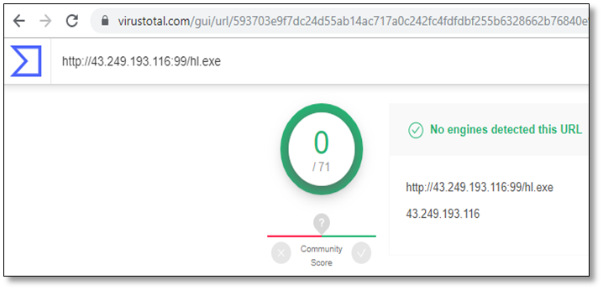
5. General DATA ANALYSIs SAMPLES CONTD’
Here we see a Dionaea captured URL being datamined for threat intelligence via Virus Total
Initial this URL seems ok with 0 engine detections. This is however, a false negative
When the URL stripped down to just the IP, it is recognized as a known malicious poor reputation potential botnet attack agent

Slide 10
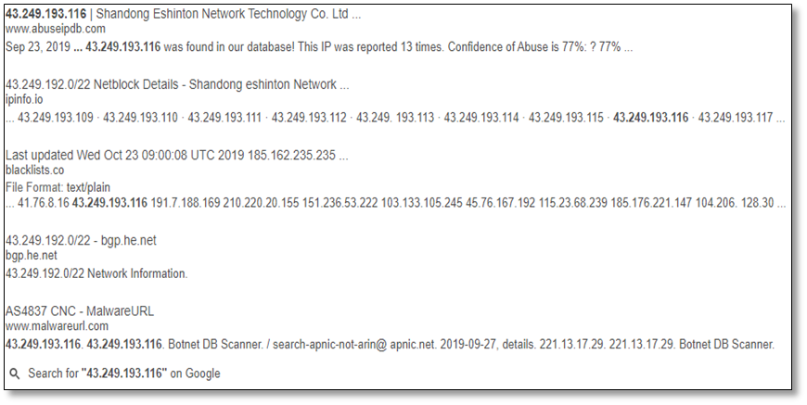
5. General DIONAEA ANALYSIs SAMPLES
Here we see threat intelligence signaling a 77% confidence that this IP is a known poor reputation IP and known botnet attack agent

Slide 11
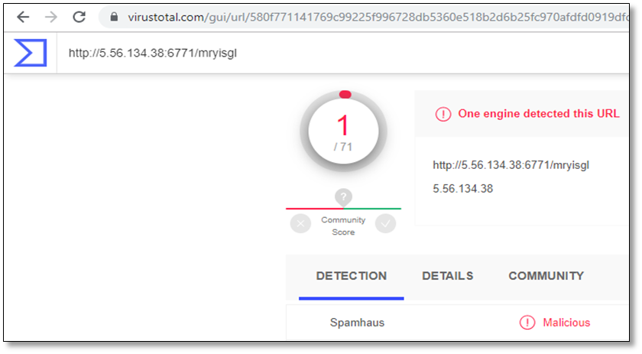
5. General DIONAEA ANALYSIs SAMPLES CONTD’
WE can see that the URL http://5.56.134.38:6771/mryisgl
Is detected by one engine
However there is more to this URL as we will see next

Slide 12
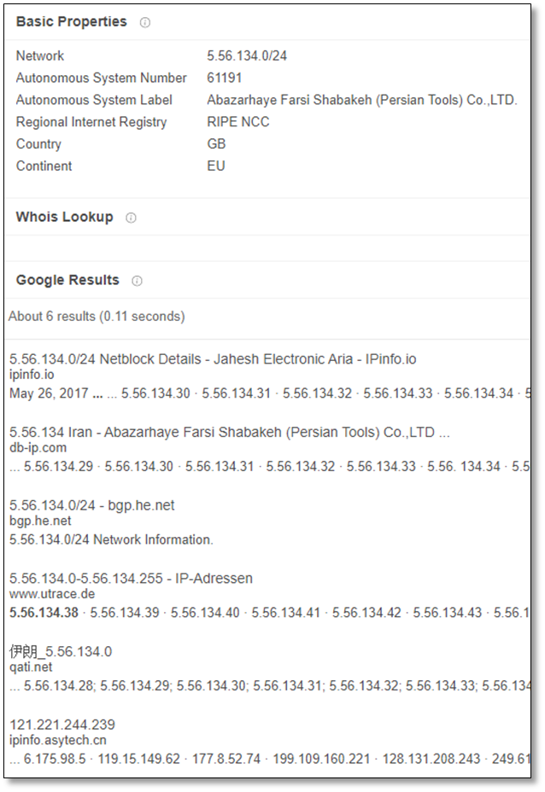
3. General DIONAEA ANALYSIs SAMPLES
Here we see threat intelligence signaling the company, registered in the UK as Persian Tools Co. Ltd, is routed through several Asian nodes including Iran suggested a VPN is being used
Iran, being a known high level threat vector nation, this IP should be considered poor reputation and monitored strictly

Slide 13
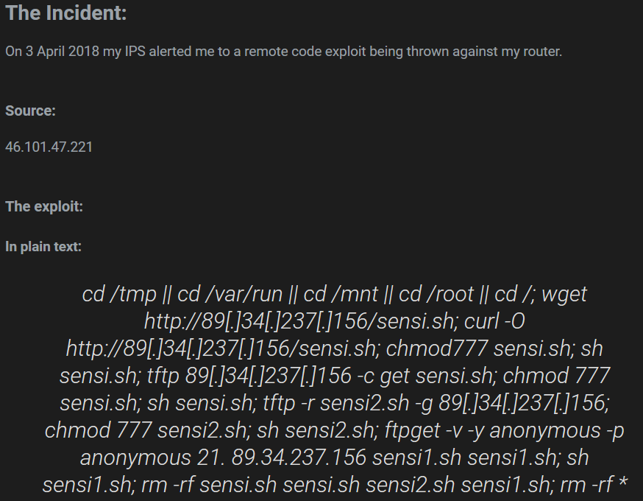
6. MoST INTERESTING HITS ON SSH PORT
The URL http://milnetbrasil.duckdns.org:8088/sensi.sh had 6 engine detections
This is know attack agent which is a multi part CVE exploit which attempts to deploy wannacry and then scan for newly connected devices every few seconds
If a new device is found it is attacked and encrypted
Critical attack which bricks devices!!!

Slide 14
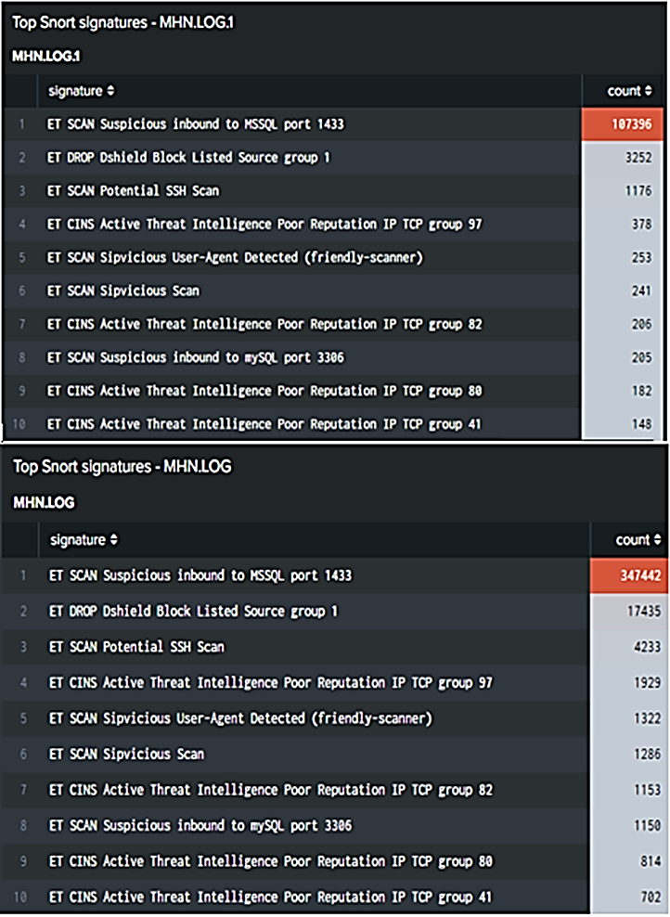
7. A ThREAT INTELLIGENCE USE CASE EXAMPLE VIA SNORT/p0f
The common threat intelligence related events detected
WE can see multiple poor IP reputation type event signatures
SSH related events
Blocked List events
Sipvicious user agent events ( VOIP pivot attempts)

Slide 15
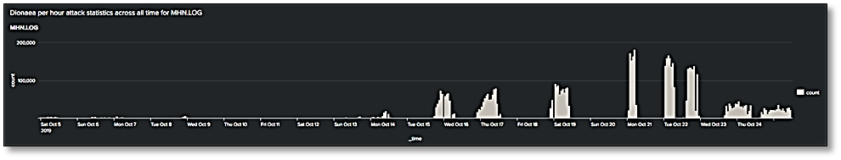
7. A ThREAT INTELLIGENCE USE CASE EXAMPLE VIA SNORT/p0f
ET SCAN Suspicious inbound to MSSQL port 1433: This is a denial of service attempt via syn-flood typically launched against MSSQL which could be mitigated via syn limiting [5].
This is likely connected to a recently discovered MySQL CVE discovered mid-October which explains the uptake in attacks per hour as this CVE was being hunted [6].

Slide 16
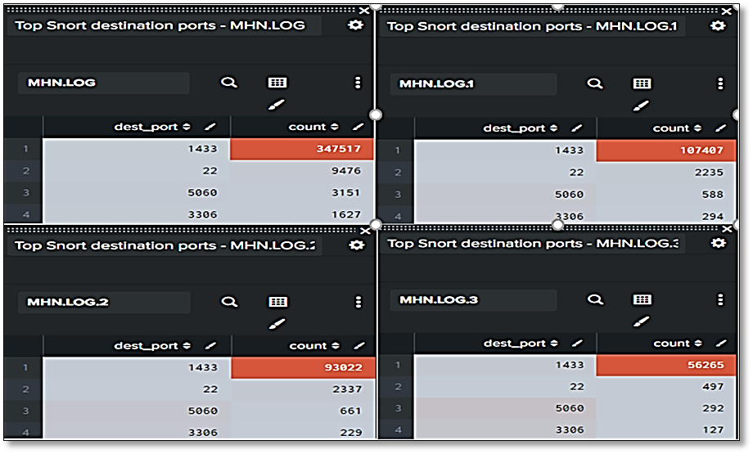
7. A ThREAT INTELLIGENCE USE CASE EXAMPLE VIA SNORT/p0f
Here we can see an uptake in ports 1433 and 3306 both related to MySQL
This suggests attack agents are scanning for an attempting to exploit the new CVE.

Slide 17
8.CONCLUSIONS
Installation is relatively simple once time is invested into trouble shooting issues
Due to the system no longer being maintained system instability is an issue and regular reinstallation and maintenance is the level of data analytics available is impressive, particularly when a tool suck as Splunk of Elk is plugged into the MHN data
Despite the issue with stability, upkeep and general flakiness of the platform the level of threat intelligence is fantastic
Malware by far the biggest threat. But by no means the only threat. Active recon/fuzzing is persistent with periodic backdoor attempts via CVE Exploitation
The Ability to identify patterns makes adapting a companies security policy and profile very easy and fast
Splunk / ELK integration is fantastic and allows the creation of a pseudo home security operations center
The proliferation of wanna-cry highlights the need for constant network vigilance and monitory as well as regular update maintenance. It is easy to see how a single IT technician becoming lazy could lead to the exposure of a wealth of information
No port is safe, no service is safe. Check twice and then check again and trust nothing

Slide 18
8. References
Virus-Total, ‘DETAILS’ [ONLINE] Available at: https://www.virustotal.com/gui/file/c05e2dab77349cd639aa837e7e121710b8a0718d8fc93fb4cc6458ae90e5c597/details [Accessed Oct. 3, 2019]
Virus-Total, ‘DETAILS’ [ONLINE] Available at: https://www.virustotal.com/gui/file/397e054981e16af9cc59d62897d9cf037470289df8844f1b6121d5e2fb6afbf0/details [Accessed Oct. 3, 2019]
Virus-Total, ‘DETAILS’ [ONLINE] Available at: https://www.virustotal.com/gui/file/cf5ddb5dedea0104a3fc464c822e6181a9dd9fa6e27e713c54af0eafb7c5faf0/details [Accessed Oct. 3, 2019]
Simple Computer Security, ‘Remote Code Exploit’, [ONLINE] Available at: https://simplecomputersecurity.blogspot.com/2018/04/remote-code-exploit.html [Accessed Nov. 3, 2019]
Tenable, ‘MySQL 5.6.x < 5.6.46 Multiple Vulnerabilities (Oct 2019 CPU)’ [ONLINE] Available at: https://www.tenable.com/plugins/nessus/130025 [Accessed Nev 3, 2019]
CVE, ‘CVE-2019-2910’, [ONLINE] Available at: https://cve.mitre.org/cgi-bin/cvename.cgi?name=CVE-2019-2910 [Accessed Nov. 3, 2019]

